Slide 1
Introduction.
Health apps are application programs that offer health-related services for smartphones and tablet PCs. Because they're accessible to patients at home.
Healthcare is the only sector that frequently deals with emergency situations
The mobile medical apps can facilitate to fix an appointment, check their health status, communicate with the doctors , Search the hospitals.
This app provide the information about the hospital list of doctors and health services.

Slide 2
Motivation
In these uncertain times of the pandemic, the worst hit are the elderly. With these vulnerable times outside, the senior citizens are the ones worst affected. They are left stranded in their houses without basic supplies and with no means to venture outside in the harsh conditions.
We intend to serve the senior citizens and provide them with every essential commodity and service from the comfort of their homes. So that they do not have to venture outside in these difficult and demanding times. This all-inclusive application aims to cater all their needs.

Slide 3
Benifits
Healthcare app provides its customers with lots of facilities like they could easily get appointments fixed with the desired doctor.
User can interact with the doctors and could check the availability of the medical reports in a very short time span.
The apps help the doctors to get updated with the current help of their patients.
Gives patients faster access to providers and care

Slide 4
Modules
4 Main modules:
1-Login Management
2-Doctor Appointment management
3-Serach Hospital
4-Medicine Reminder

Slide 5
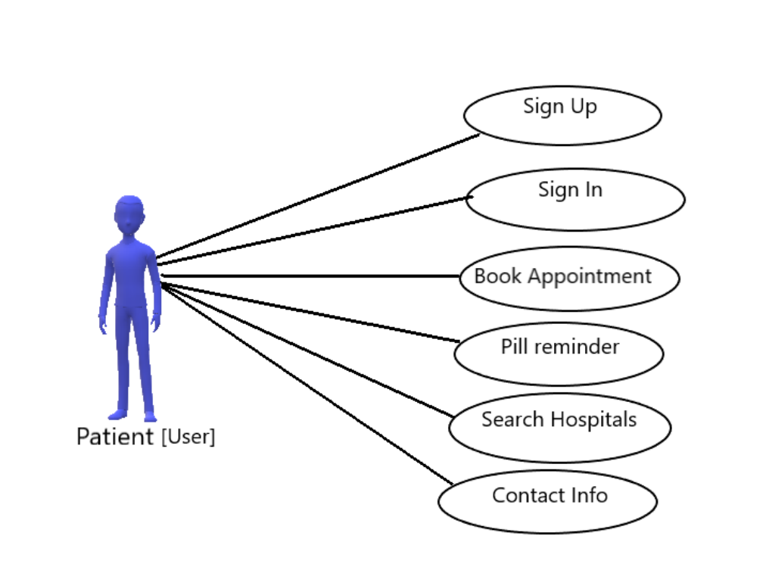
Used case digram

Slide 6
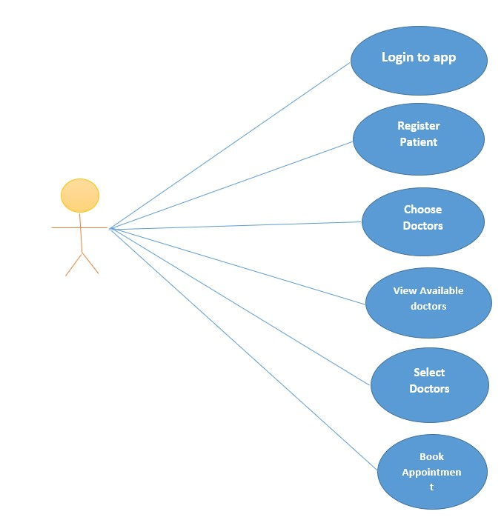
UML Diagram

Slide 7
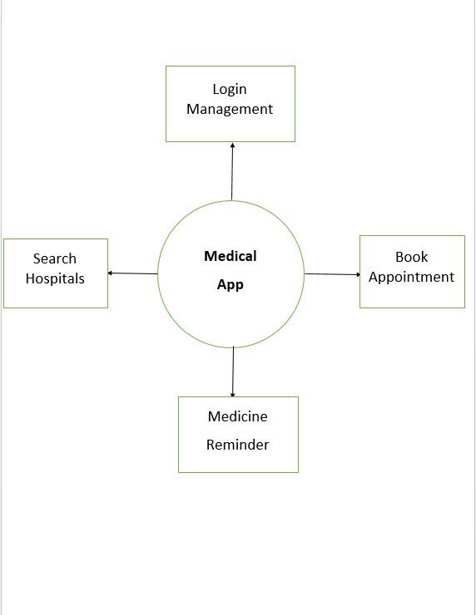
DFD Diagram

Slide 8
Problem Statement.
Develop an effective application to address the needs of the elderly people in the pandemic, as well as post pandemic by making them available medicines..
Also providing first aid to address emergencies and easy contact with local doctors and specialists.
Pill reminder facility to ensure the pills are taken

Slide 9
Literature Survey.
Sr. No | Paper Title | Authors | Year of Publicatio n | Outcome
1. | Automatic pill reminder for easy supervision [2] | A. Jabeena; Animesh Kumar Sahu; Rohit Roy; N. Sardar Basha | 2018 | This paper proposes a working model of an automatic pill reminder and dispenser setup is introduced that can alleviate irregularities in taking prescribed dosage of medicines at the right time dictated by the medical practitioner.
2. | Smart phone based medicine in-take scheduler, reminder and monitor [3] | John K. Zao; Mei Ying Wang; Peihsuan Tsai; Jane W.S. Liu | 2010 | This paper proposes a smart phone application that helps patients to avoid these mistakes. It can remind its users to take the correct medicines on time and keep an in take record for later review by healthcare professionals. It works with the calendar application available on most smart phones to issue medicine and meal reminders. It also shows pictures of the medicine and provides succinct in-take instructions.

Slide 10
Future Scope
This Project work aims to improve the health care facilities in the rural areas. It also aims at providing improved information and communication facilities between the health care officials and the rural population.
Various hospitals, nursing homes, health centers are hiring healthcare professionals like health insurers.
The healthcare system is expanding in the field of mobile applications, as there are now more than 1,500,000 mobile applications in the business. People use these medical and health services apps in order to meet their respective needs

Slide 11

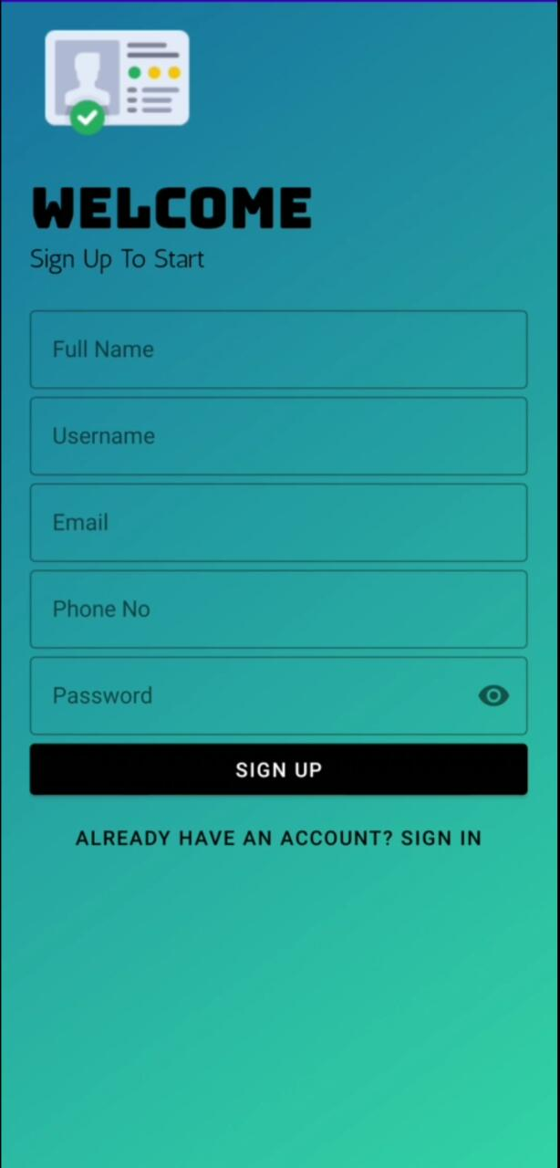
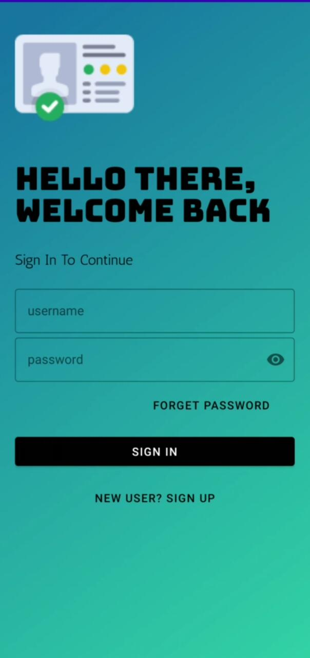
Login Page

Slide 12
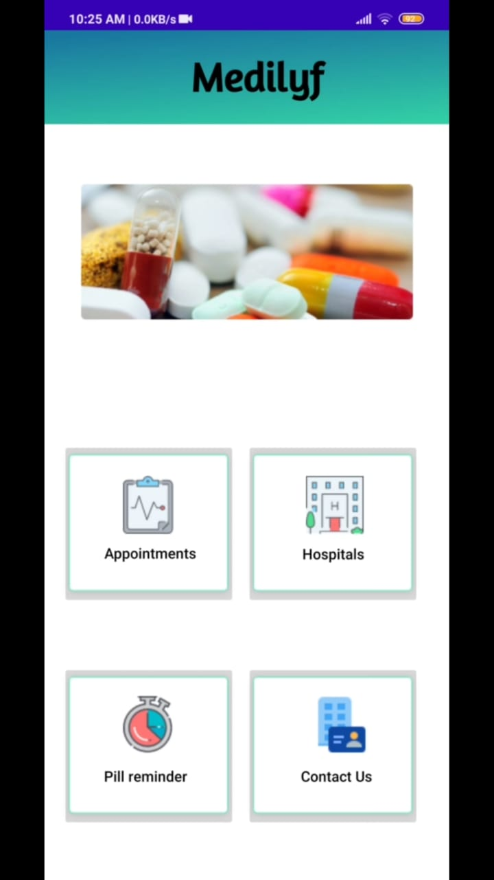
HOME page

Slide 13
Conclusion.
Although this project is made for over small scale of location but if we implement new technologies & features in the system, it will be able to compete with other online Medical app and doctor consultation websites or application.
In this project user we can book appointments with the doctor using this system. This project hopes to develop a doctor consultance and medicine reminder and to search hospitals Android app with high Quality user interface

Slide 14
References.
1[ E.Balagurusamy , “ Programming with Java”, Seventh Edition,2011
[2] “Android Studio Download”, https://developer.android.com/studio, dated:14-12-2018
[3] “Git Hub Tutorials”
[4] “Sqlite Databse ” https://developer.android.com/training/datastorage/sqlite

Slide 15
THANK YOU

